Slide 1
SOFTWARE DEFECT PREDICTION
Final Project - Research Question
Akhilesh Potturi – Z1942158
Nikhitha Jetling – Z1924282

Slide 2
Research Question
Finding out an efficient method to predict the software defect in the code?

Slide 3
Attribute List
1. loc : numeric % McCabe's line count of code
2. v(g) : numeric % McCabe "cyclomatic complexity"
3. ev(g) : numeric % McCabe "essential complexity"
4. iv(g) : numeric % McCabe "design complexity"
5. n : numeric % Halstead total operators + operands
6. v : numeric % Halstead "volume"
7. l : numeric % Halstead "program length"
8. d : numeric % Halstead "difficulty"
9. i : numeric % Halstead "intelligence"
10. e : numeric % Halstead "effort"
11. b : numeric % Halstead
12. t : numeric % Halstead's time estimator
13. lOCode : numeric % Halstead's line count
14. lOComment : numeric % Halstead's count of lines of comments
15. lOBlank : numeric % Halstead's count of blank lines
16. lOCodeAndComment: numeric
17. uniq_Op : numeric % unique operators
18. uniq_Opnd : numeric % unique operands
19. total_Op : numeric % total operators
20. total_Opnd : numeric % total operands
21: branchCount : numeric % of the flow graph
22. defects : {false,true} % module has/has not one or more reported defects

Slide 4
DataSet
The dataset has two classes; True and False
This is an imbalance dataset, as there is high difference between the two classes(49 true values and 449 False values)
So, we need to balance the dataset, so that approximately half of the distribution represents the True class and the other half represents the False class

Slide 5
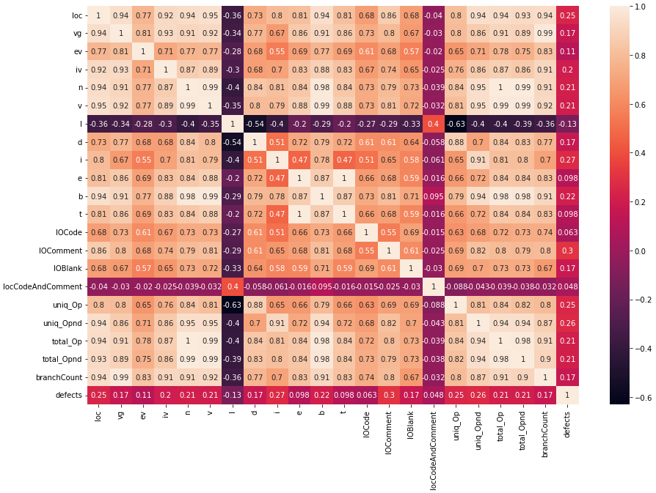
Heat Map (Correlation between Features)

Slide 6
Methods Used to remove correlation
From the HeatMap as we can see, there a lot of correlation between most of the features, to remove this correlation, we have used two methods.
We have dropped the features which have correlation greater than 0.9
We have used PCA(Principal Component Analysis) to remove correlation as it converts highly correlated features into set of uncorrelated features.

Slide 7
Balancing the dataset
We have balanced the Dataset using four methods
RandomOverSampling
RandomUnderSampling
EditedNearestNeighbours
SMOTE

Slide 8
Models used for predicting the Software Defect
Logistic Regression
Naive Bayes
K-Nearest Neighbour
Decision Tree
Random Forest
Gradient Boosting

Slide 9
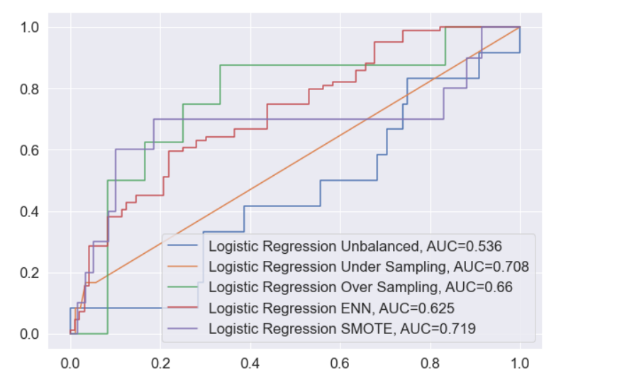
Logistic Regression
Hyper Parameters Used for grid search:
C = [0.001, 0.01, 0.1, 1, 10, 100, 1000]
Model | Accuracy | ROC AUC | Precision | Recall
LG | 0.88 | 0.536 | 0.5 | 0.08
RU_LG | 0.7 | 0.708 | 0.6 | 0.75
RO_LG | 0.661 | 0.66 | 0.64 | 0.64
ENN_LG | 0.855 | 0.625 | 0.5 | 0.3
SMO_LG | 0.717 | 0.719 | 0.68 | 0.75

Slide 10
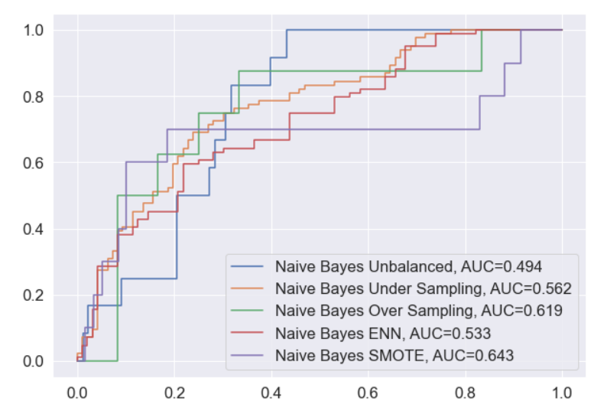
Naïve Bayes
Hyper Parameters Used for grid search
Var smoothing = np.logspace(0,-9, num=100)
Model | Accuracy | ROC AUC | Precision | Recall
NB | 0.87 | 0.494 | 0.0 | 0.0
RU_NB | 0.65 | 0.562 | 1.0 | 0.12
RO_NB | 0.639 | 0.619 | 0.77 | 0.32
ENN_NB | 0.841 | 0.533 | 0.33 | 0.1
SMO_NB | 0.661 | 0.643 | 0.79 | 0.37

Slide 11
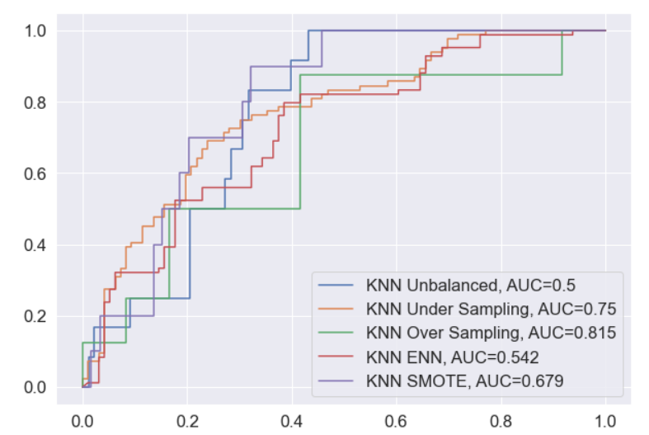
K-Nearest Neighbor
Hyper Parameters Used for grid search:
n_neighbors = [5,7,9,11,13,15]
Model | Accuracy | ROC AUC | Precision | Recall
KNN | 0.88 | 0.5 | 0.0 | 0.0
RU_KNN | 0.75 | 0.75 | 0.67 | 0.75
RO_KNN | 0.806 | 0.815 | 0.72 | 0.96
ENN_KNN | 0.855 | 0.542 | 0.5 | 0.1
SMO_KNN | 0.672 | 0.679 | 0.62 | 0.77

Slide 12
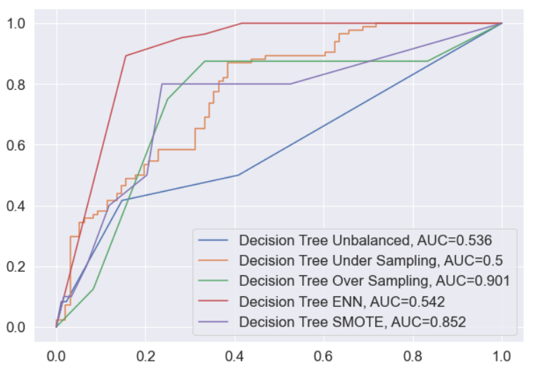
Decision Tree
Hyper Parameters Used for grid search:
Max Depth = range(1, 20)
Min_Samples_leaf = range(2, 20)
Criterion = [‘gini, ‘entropy’]
Model | Accuracy | ROC AUC | Precision | Recall
DT | 0.88 | 0.536 | 0.5 | 0.08
RU_DT | 0.5 | 0.5 | 0.4 | 0.5
RO_DT | 0.894 | 0.901 | 0.82 | 1.0
ENN_DT | 0.855 | 0.542 | 0.5 | 0.1
SMO_DT | 0.85 | 0.852 | 0.81 | 0.88

Slide 13
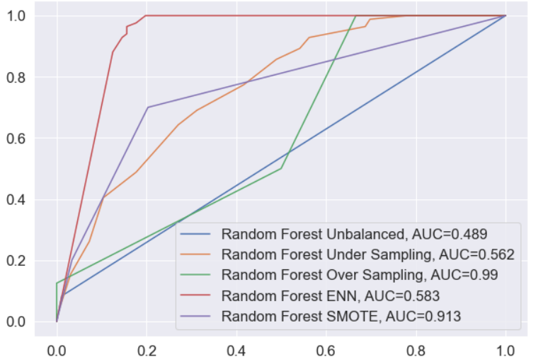
Random Forest
Hyper Parameters Used for grid search:
n_estimators = [200. 400, 600]
Max_depth = [10,20,30]
bootstrap = [True, False]
Model | Accuracy | ROC AUC | Precision | Recall
RF | 0.86 | 0.489 | 0.0 | 0.0
RU_RF | 0.6 | 0.562 | 0.5 | 0.38
RO_RF | 0.989 | 0.99 | 0.98 | 1.0
ENN_RF | 0.855 | 0.583 | 0.5 | 0.2
SMO_RF | 0.911 | 0.913 | 0.88 | 0.94

Slide 14
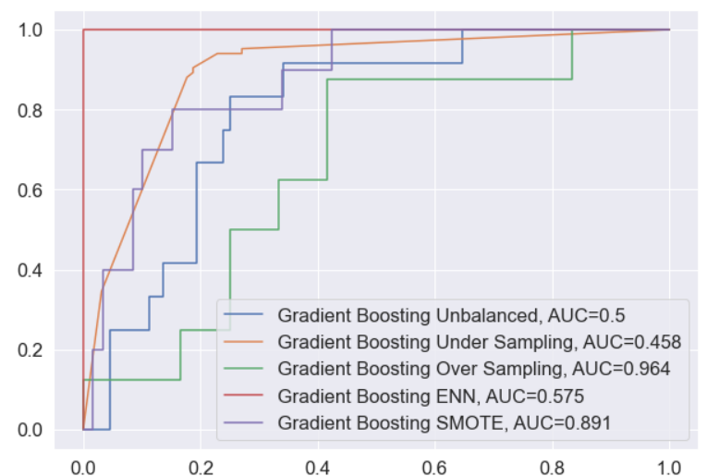
Gradient Boosting
Hyper Parameters Used for grid search:
n_estimators = [10, 50, 100, 500]
learning_rate = [0.0001, 0.001, 0.01, 0.1, 1.0]
Model | Accuracy | ROC AUC | Precision | Recall
GB | 0.88 | 0.5 | 0.0 | 0.0
RU_GB | 0.5 | 0.458 | 0.33 | 0.25
RO_GB | 0.961 | 0.964 | 0.92 | 1.0
ENN_GB | 0.841 | 0.575 | 0.4 | 0.2
SMO_GB | 0.889 | 0.891 | 0.86 | 0.92

Slide 15
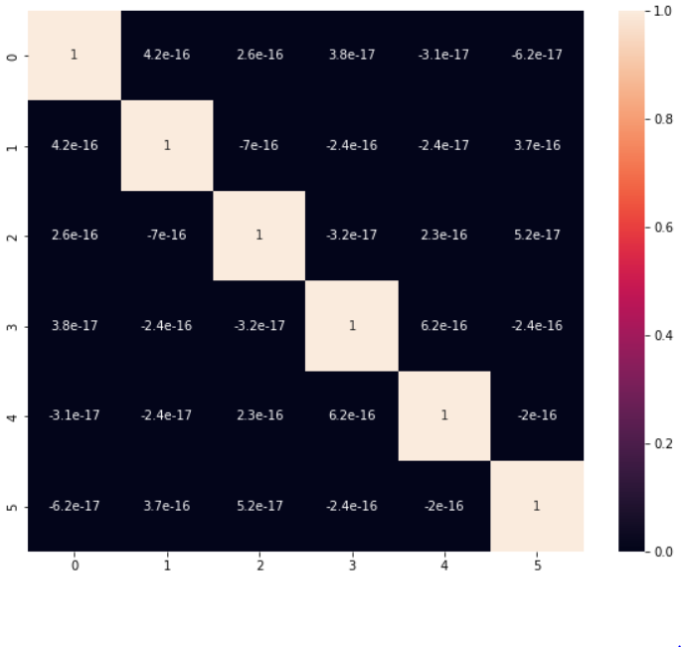
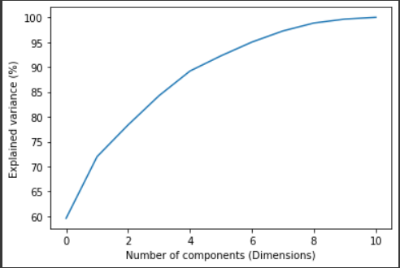
PCA(Principal Component Analysis)

Slide 16
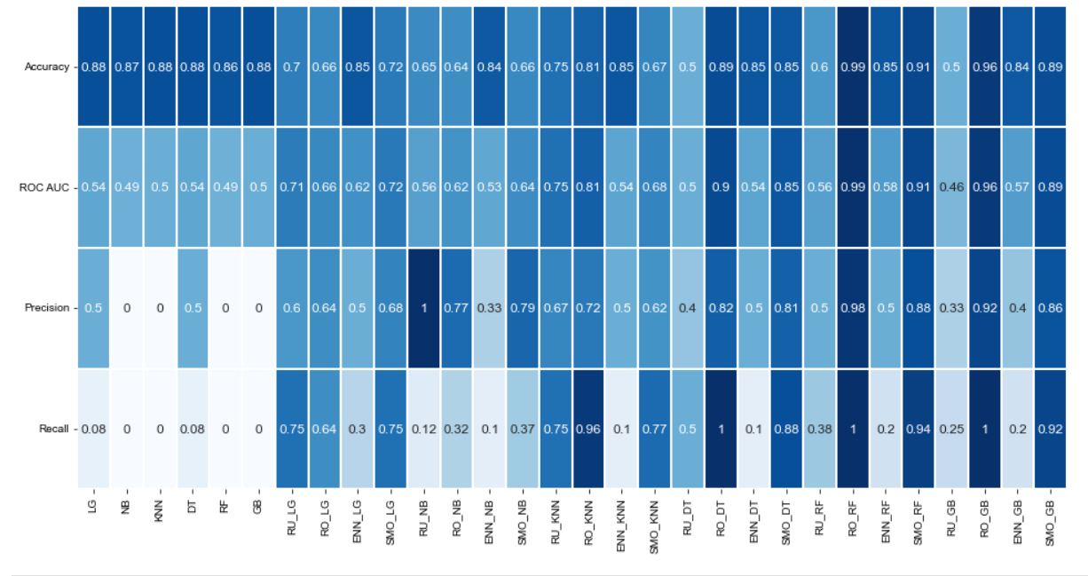
Results using 1 method of removing correlation

Slide 17
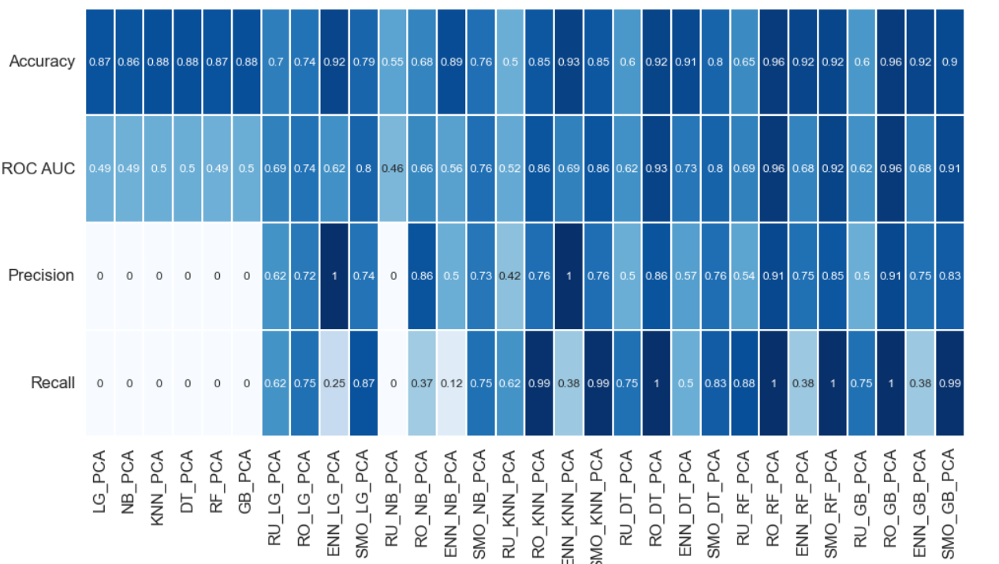
Results using PCA

Slide 18
Conclusion
Balancing the dataset giving us the better results in predicting the software defect
Random Oversampling balancing technique is giving better results than random under sampling balancing technique
Both PCA and 1st method used to remove correlation are giving almost similar results in predicting software defect. For some models, PCA worked better and for some models 1st method worked better

